Slide 1
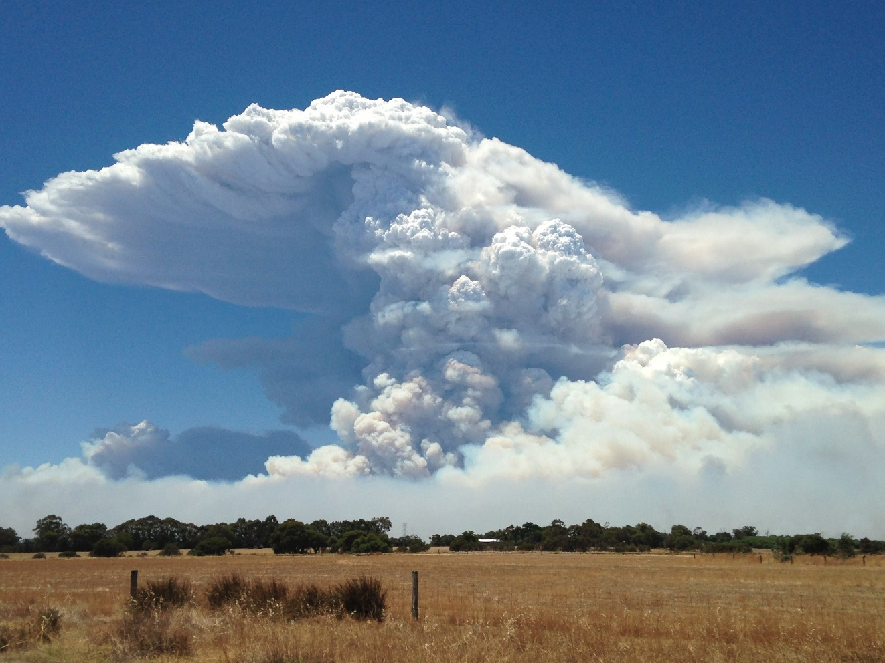
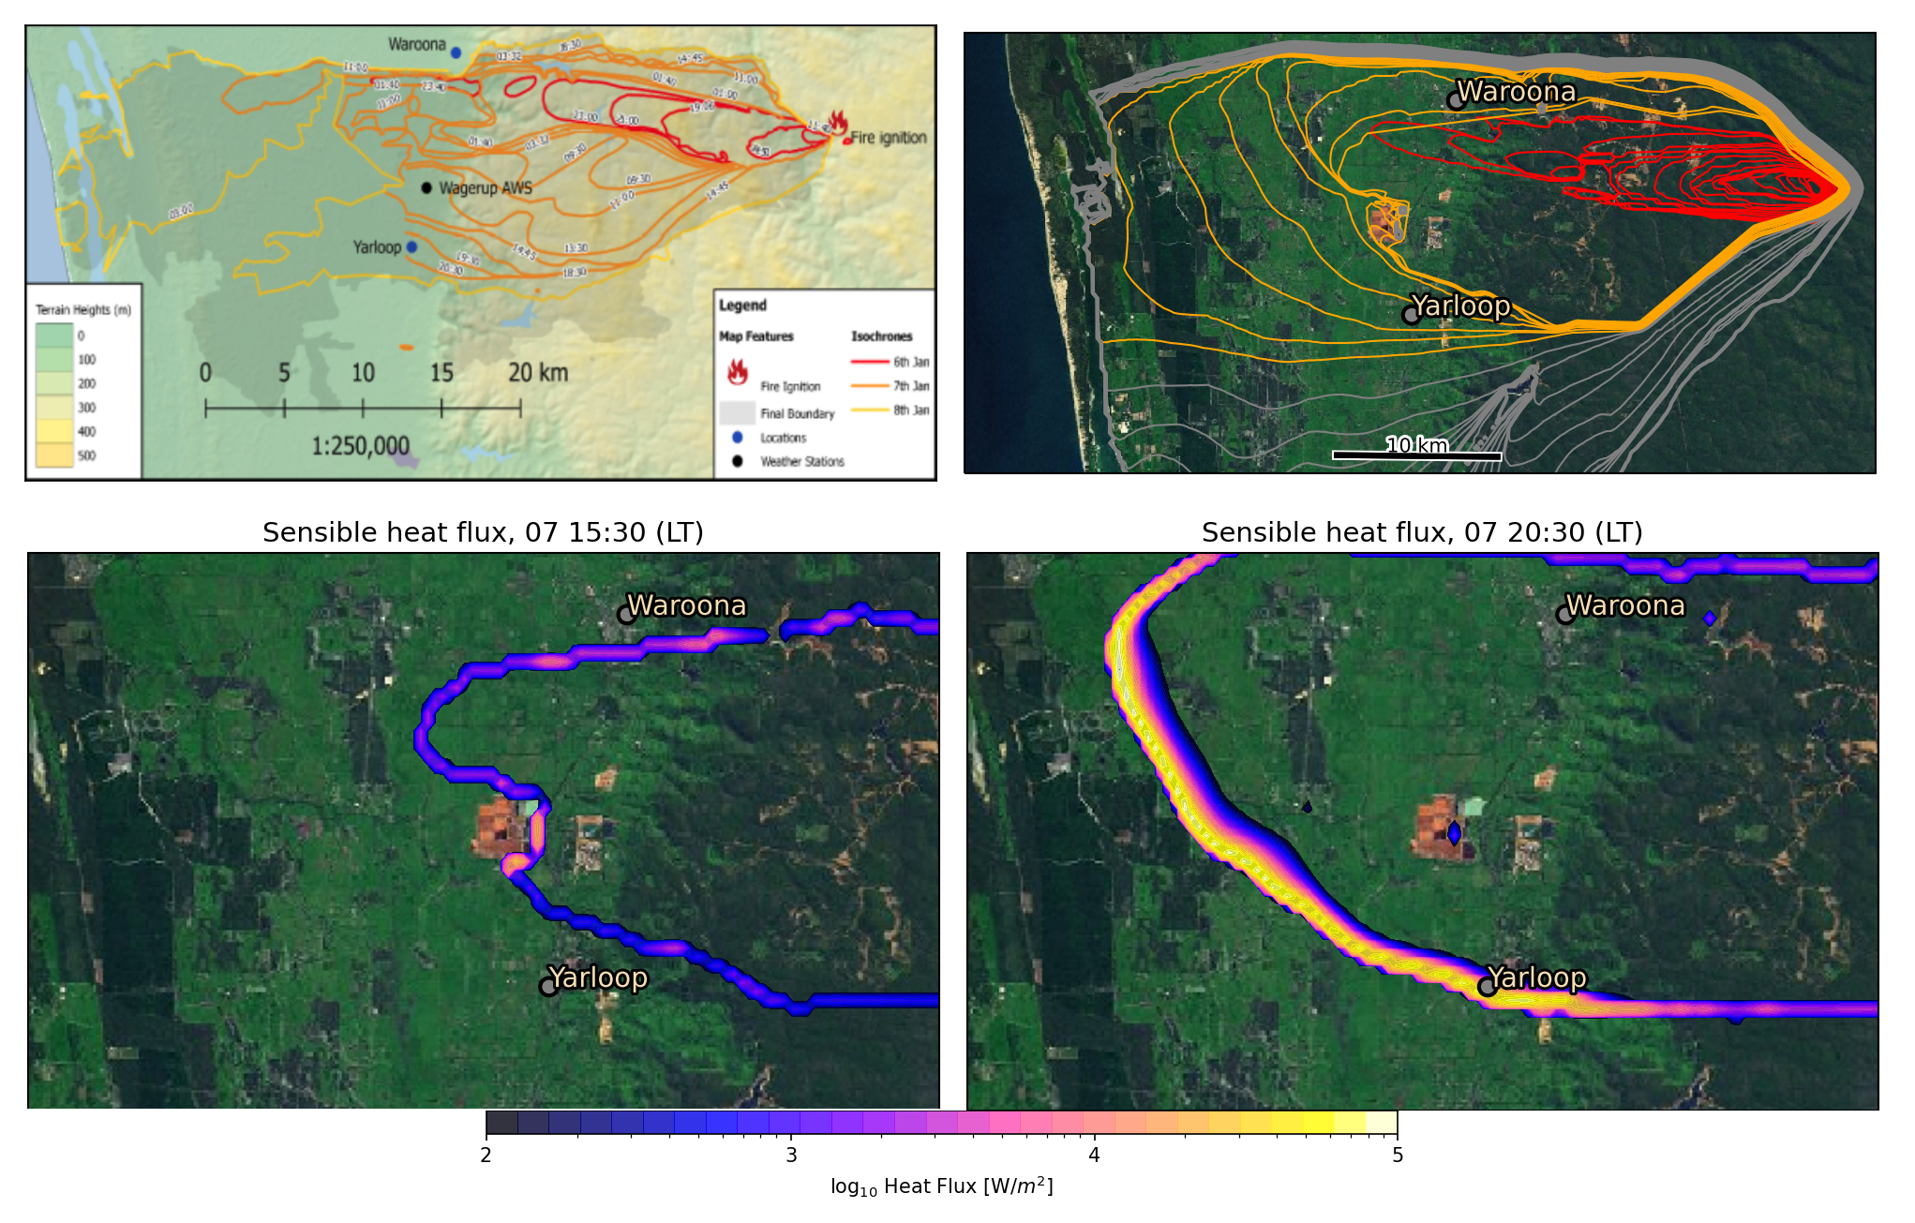
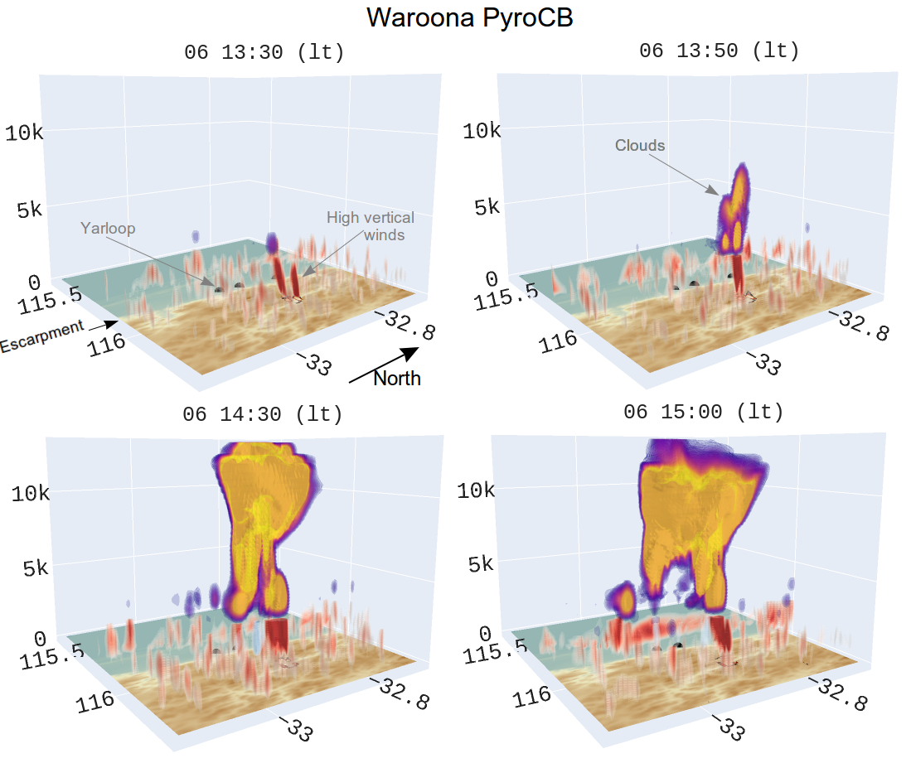
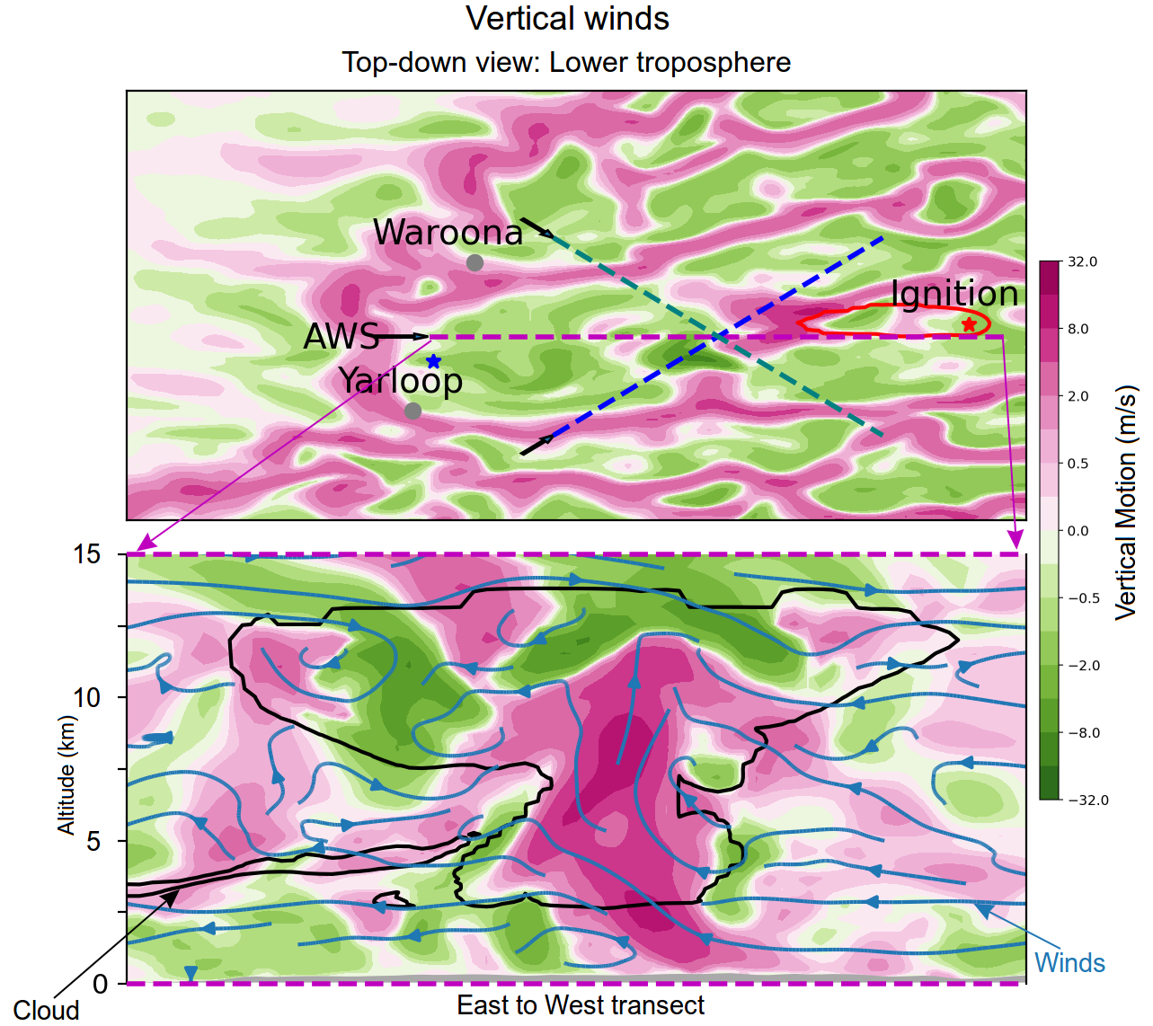

findings
Coupled modelling can provide the next level of value for fire danger forecasting, if it can be developed to the point where it is both faster than real time by enough to matter, and good quality fuel data are available.
ACCESS-Fire: a case study
Jesse Greenslade¹, Mika Peace^{1,2}, Jeffrey D Kepert^{1,2}, Harvey Ye¹
¹ Bureau of Meteorology
² Bushfire and Natural Hazards CRC, Victoria
This work examines fire spread and related weather phenomena in a large-scale high-intensity fire over complex topography using a coupled atmosphere and fire spread model ACCESS-Fire. The simulated fire occurred in 2016, igniting ~20 km East of Waroona WA, and frequently diverged from forecast fire danger metrics. This is due to the fire generating its own weather systems and requires coupled modelling to analyse and forecast.
Introduction
ACCESS is the Australian Community Climate and Earth-System Simulator - Australia's premier numerical weather prediction model. Coupled to a fire model developed at BOM it allows pyrogenic heat and moisture to feed back into the simulated atmosphere.
The top left panel shows fire spread over three days, while the top right panel shows modelled spread for much of the first day (red), and the last nine hours of the second day (orange). Simulated spread does not include suppression efforts that occurred between Waroona and Yarloop. Ignition points (and spotting) are prescribed in the model. The bottom two panels show heat output at two different times. Notably both spread and damage are qualitatively similar for these two days.
PyroCB near Waroona, 2016
Pyrocumulonimbus (PyroCB)
The coupled model captured several PyroCB that were seen (e.g. top-right). These often cause strong surface winds and lightning, both of which lead to unexpected fire spread. Waroona PyroCB were the most likely cause of downwind spotting on the first day of the fire, as burning embers are lifted in the elevated updrafts and turbulence.
The figure to the right shows PyroCB seen near Waroona, along with the formation seen in ACCESS-Fire output. The output is shown on 3D model levels up to 13.5km altitude above ground level, over topography with the escarpment labelled in the top left panel. The cloud formation follows high energy output at a time when the fire front expands rapidly westwards. This matches what was seen in the field.
The figure here shows a slice through the same PyroCB, highlighting the vertical motion (updrafts in pink and downdrafts in green). The updraft generated by the fire front can be seen to extend up to almost 13 km. The scale of this PyroCB is almost 40 km from east to west – lightning generated fires could easily occur distant from the front.
Discussion
Coupled modelling can clearly capture complex phenomena such as PCB and downslope fire spread. This is a step towards improved understanding and forecasting of these deadly events.
Fire spread is accurate but requires realistic estimation of potential downwind spotting.
PyroCB Formation and impacts could add value to danger warnings for fire suppression crews.
Complex topography can lead to complex weather phenomena, which are difficult to accurately forecast using traditional fire danger indices.
We can now run these simulations in better than real time, allowing, with the necessary infrastructure, for the possibility of operational use
Modelled PyroCB formation: clouds form due to massive heat output as the fire spreads. Updrafts are shown in red in the lower 2 km of atmosphere.
For more information, please email jesse.greenslade@bom.gov.au

